Slide 1
Medical
1
Pharmacy
The pharmacy can be referred to as the clinical health science which plays the role of linking medical science with chemistry and it is responsible for the discovery, disposal, production, effective nd safe utilization, and control of drugs and medications. It is essential to have a pharmacy in a hospital. Our pharmacy has everything imaginable. All medications are always available. Click on the map to see where our pharmacy is located in our hospital.
Green Ward
The Green Ward is on the first floor. This ward is reserved
for doctors' visits and outpatients.
Emergency
Emergency room or area staffed and equipped for the reception and treatment of persons requiring immediate medical care : a room in a hospital with doctors, nurses, and medical equipment for treating people who need medical care immediately
Rainbow Ward
Rainbow Ward is located on the third level. This ward is devoted to children. This ward is colourful and wonderful for making children feel more comfortable.
Yellow Ward
Yellow ward is located on the second floor. This ward is dedicated for all the operations that needs to take place in our hospital.

Slide 2

Non-Medical
1
Cafetria
Atm
Our cafeteria is on the first level. There one can find drinks, food, sweets etc..
An automated teller machine (ATM) is an electronic banking outlet that allows customers to complete basic transactions without the aid of a branch representative or teller. There is an ATM near the hospital's entrance.
Toilets
Every level has about 5 toilets for women's, men's, and handicap access. They are always kept clean.
Vending Machines
There too many vending machine
in our hospital that sells items such as snacks,
beverages, orange juices and coffee after they insert cash.
Stationary
Our stationery is on the first level.
There are many various kinds of cards, candies, soft
toys, and stationery available.
www.yourwebsite.com

Slide 3

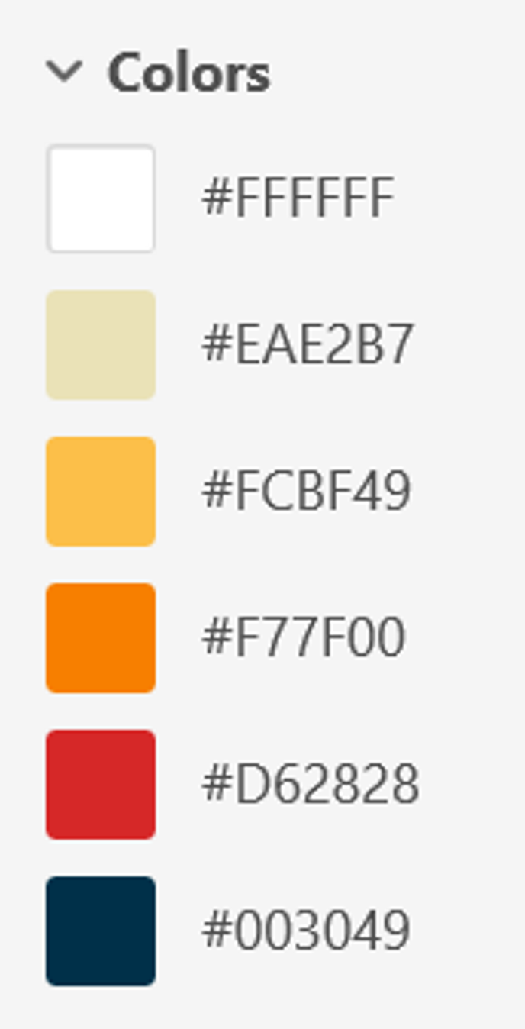
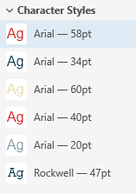




24 Hour Homecare
Icons

Slide 4
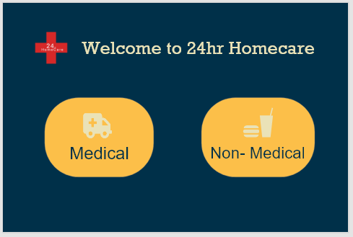
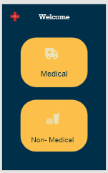
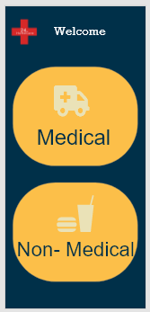
24 Hour Homecare
Responsive Tablet Mobile

